Slide 1

Applications of Machine Learning in Improving Spatial Resolution of Modeled Weather Datasets
Md Fahim Hasan
Global Vegetable Phenotyping
Vegetable R&D APD Intern
01 August 2023

Slide 2


About Myself
Md Fahim Hasan
goes by Fahim
PhD Student (1st year)
Department of Civil Engineering
Colorado State University
Research Focus:
irrigation groundwater quantification/monitoring
satellite, weather, in-situ data
machine/deep learning
Groundwater modeling using processed-based models
At Bayer
Vegetable R&D APD Intern
Global Digital Phenotyping
Hobbies: Travel, Soccer, Socializing, Cleaning.
Obsessed about: Star Wars, Harry Potter, Action/Sci-fi
LinkedIN

Slide 3
Motivation: Business and Technical
Framework for Analysis-Ready Datasets (ARD)
Machine Learning/Deep Learning Model Results and Discussion
Case Study: ARD in Environmental Clustering App
Future Steps and Summary
Agenda

Slide 4
1. Motivations: Business and Technical

Slide 5
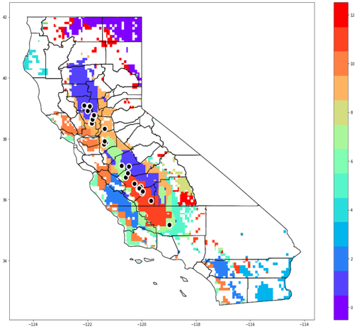
Business Motivation
Environmental Clustering App is developed by Veg R&D APD to enable rapid, effective and scalable production of clustering maps across various crops and regions
It unlocks potential business values and are used across Veg R&D and in many other Bayer organizations
Bottleneck for high-resolution long-term weather data:
Low spatial resolution – long temporal records
High spatial resolution – short temporal records
Solution: Machine Learning + spatial interpolation-based framework: Harmonizing datasets to high-resolution
G x E
Testing Footprint Optimization
Alternative Testing Location
Market Expansion
understanding of germplasm response
Environmental
Clustering App
*Developed by Ariel Wang & Xing Weng in Veg APD
Notes:
-The business motivation of this project comes from the environmental clustering app developed by Veg R&D APD. This app enables rapid, effective and scalable production of clustering maps across various crops and regions like shown here for the California region.
It is used by teams across Veg R&D and in multiple Bayer organizations, and unlocks multiple potential business values including but not limited to the ones listed ’the list’
This web app uses inputs: 20-yrs of weather data, soil, elevation data., but the bottleneck for improved resolution arises due to unavailability of high-resolution long-term weather data.
The current weather datasets are of lower spatial resolution-long temporal records and higher spatial resolution – short temporal records.
To improve the web app clustering performance, we need to have high spatial resolution long term datasets.
So, we propose a machine learning + spatial interpolation-based framework that will harmonize all datasets including the weather datasets to high spatial resolution.

Slide 6
Env. Clustering
Other Env. Model
Framework to develop ARD
Different Regions
Different Resolution
(Low to High)
Different Variables
Business Motivation
Disease Models
Crop Models
Notes:
Even though we build the framework for improving the datasets required for the Env Clustering App, it has other business impact.
- The framework can be used for improving resolution of different variables and is scalable for any region.
- In addition, the framework can be integrated to other environmental models, crop and disease models that require high-resolution weather data.
- In summary, the framework has the potential to improve many models used across Bayer.

Slide 7
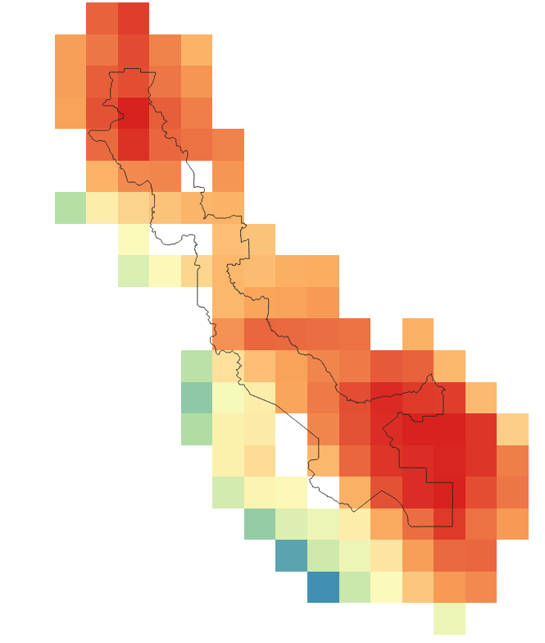
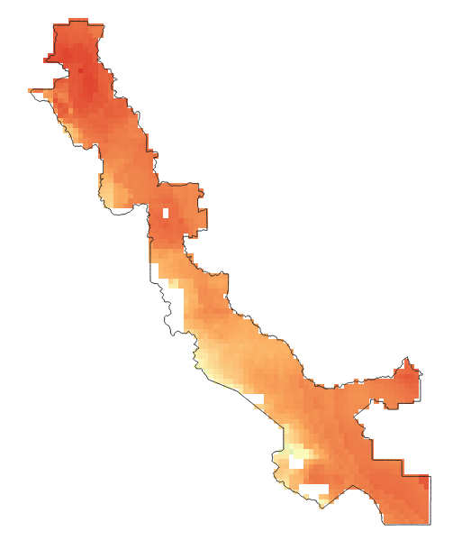
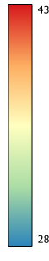
Technical Motivation: Improving Weather Data Resolution
ECMWF Reanalysis V5 (ERA5) : Low spatial resolution (28km); Extended (1979-present) daily temporal records.
The Weather Company (TWC):
Historical : High spatial resolution (4km); Limited (2015-2023) daily temporal records.
Hi-Res Precipitation : High spatial resolution (8km); Limited (2015-2023) daily temporal records.
Input Variable
Training Data
28 km
4 km
4 km
Framework Interpolated high resolution (4km) daily weather datasets
deg C
28 km
ERA5 Max Temperature
TWC Max Temperature
Notes:
- LI have been talking about improving spatial resolution of weather data. How do we do that? That the technical motivation of this project.
First is ERA5 which is of low spatial resolution 28km but has extended temporal records at daily scale.
This is how the ERA5 spatial resolution look like for our study region: a part of Sacramento valley in California
Second, there is TWC datasets. The TWC historical weather datasets are of 4km spatial resolution and TWC high-resolution precipitation data is of 8km spatial resolution.
The TWC datasets are available for a short time frame at daily scale.
This is how the TWC spatial resolution looks like for our study area.
Our objective is to improve the resolution of ERA5 datasets to a resolution of 4km using a framework where ERA5 variables will be used as input variables and TWC datasets will be used as training data.
We are choosing 4km as the target resolution because the TWC weather datasets (except precipitation) are of 4km resolution.

Slide 8
2. Framework for Analysis-Ready Datasets (ARD)

Slide 9
ARD Requirement
Two Analysis-Ready Datasets (ARD) frameworks for different spatial resolutions-
4km Resolution Framework
100m Resolution Framework (with satellite data)
Data | Variables | Source | Resolution
Weather | Temperature, Humidity, precipitation... | ERA5 TWC | 28km 4km
Soil | Sand/Silt %, Bulk Density, Available Water Capacity... | Soil250 | 250m
Elevation | - | SRTM DEM | 30m
Land Surface Temperature | - | Satellite data: Planet Labs | 100m

Slide 10
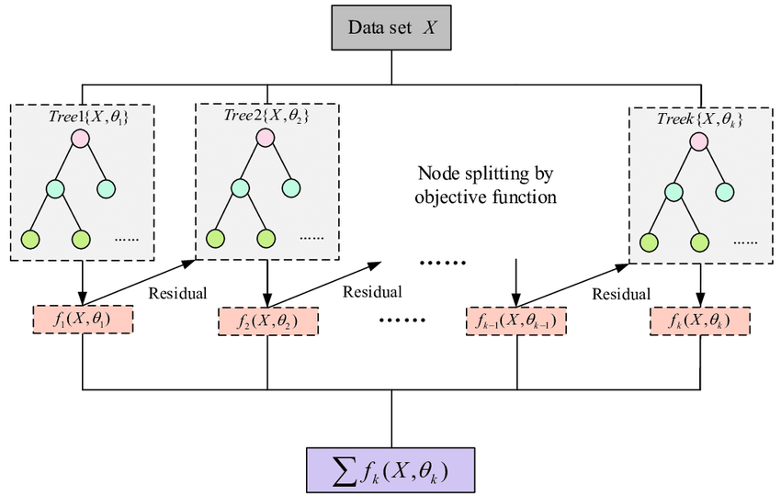
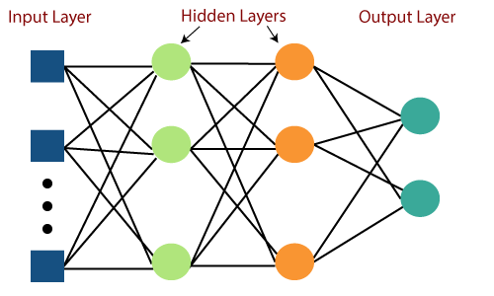
ML/DL Model Frameworks
Machine Learning
Gradient-based One-Side Sampling (GOSS) from LightGBM: an advanced form of Gradient Boosting Decision Tree
input variables: ERA5 datasets, Topography, lat/lon, month; training data: TWC datasets
80-20 train-test split by date
Output
Deep Learning
Multi-Layered Perceptron (MLP)
Getting a lot of focus recently (Gonzalez 2023, Wang et al. 2022, Sha et al. 2020, Anh et al. 2019)
Figure Source: LGBM Decision Tree, Multi Layer perceptron in Tensorflow
Notes:
- Used a type of gradient Boosting type decision tree called GOSS.
- uses the residuals of previous tree to improve results in the next tree. Finally gives the outputs when residuals ane minimized.
- fast algorithm for large dataset
- Minimal overfitting if tuned
We implemented DL is total precipitation model because there are many new studies based on DL
We implemented MLP for the precipitation model. The MLP has input layers (where we introduce the variables). The hidden layers is the architecture of the model which need to be figured out for achieving good performance, in the output layer we have the model results.

Slide 11
4km resolution Framework
Input Variables
ERA5
4km resolution
Model interpolated daily weather datasets
Elevation
ML/DL Model
ARD at 4km Resolution
Data Query from CSW
Elevation
Data Resampling to
4km Resolution
TWC
Soil250
Soil250
Training Data
4km resolution as the target resolution based of TWC’s spatial resolution.
Notes:
Emphasize on Soil250 and Elevation Data.

Slide 12
100m resolution Framework
Input Variables
ERA5
4km resolution
Model interpolated daily weather datasets
Resample to 100m resolution
Elevation
ML/DL Model
Data Query from CSW
Data Resampling to
4km Resolution
TWC
Soil250
Training Data
Satellite LST
ARD at 100m Resolution
100m resolution as the target resolution based of satellite LST’s spatial resolution.

Slide 13
3. ML/DL Model Results and Discussion

Slide 14
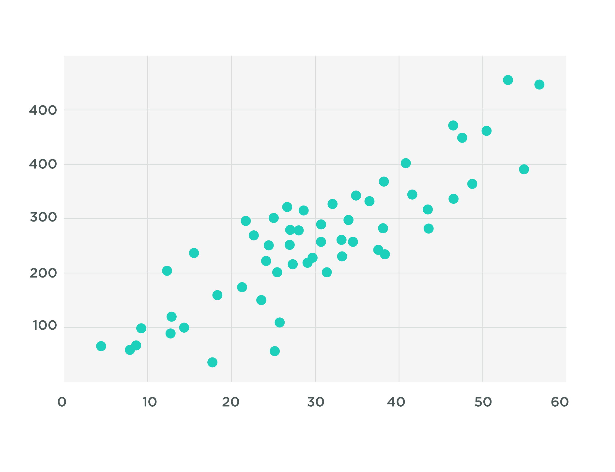
ML/DL Models: Results Summary
ML model improves R² in both train and test dataset for the weather variables expect for the ML/DL model for total precipitation.
R² between resampled ERA5 data (4km) and TWC Data (4km)
R² between modeled ERA5 data (4km) and TWC Data (4km)
R² (Coef. Of Determination)
Goodness of fit
Variable | R² without Model | R² with trained Model (Train Set) | R² with trained Model (Test Set)
Max Temperature | 0.968 | 0.989 | 0.987
Min Temperature | 0.813 | 0.971 | 0.960
Average Wind Speed | 0.442 | 0.915 | 0.896
Average Relative Humidity | 0.797 | 0.948 | 0.940
Average Temperature | 0.825 | 0.989 | 0.987
Total Precipitation | 0.509 | 0.582 | 0.504
Model
Data
Notes:
I will start with ML/DL model result summary first. Here are 6 weather variables for which I implemented machine learning
For each variable, I am using R2 to explain the strength between datasets.
I will clarify R2 in short to better explain the model results.
If we focus on the left plot, we can see some dots or points. The straight line represents the regression model fitted on the dots.
The goodness of fit of this regression model is explained by R2 (coef. of determination). The higher the R2 value is close to 1, the better is the model results.
R2 is calculated between the modeled value on the line and the original green dots.
Now, let’s move into the table. We have implemented machine learning and deep learning on 06 weather data.
The second row shows the correlation between original ERA5 variable and TWC variable before applying ML model.
The R2 values are good. For example, maximum temp has a very good R2 score close to 1. But there are scopes of improvement.
After implementing ML, the R2 values improves as shown in 3rd and 4th column. We can see improved R2 value between model interpolated weather variable and TWC training data.

Slide 15
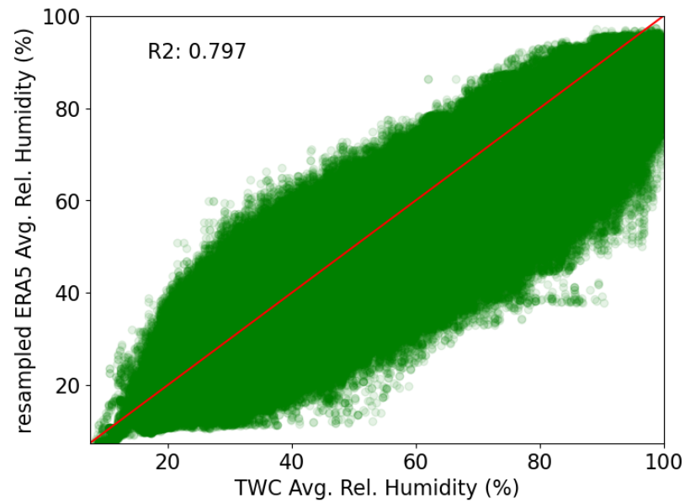
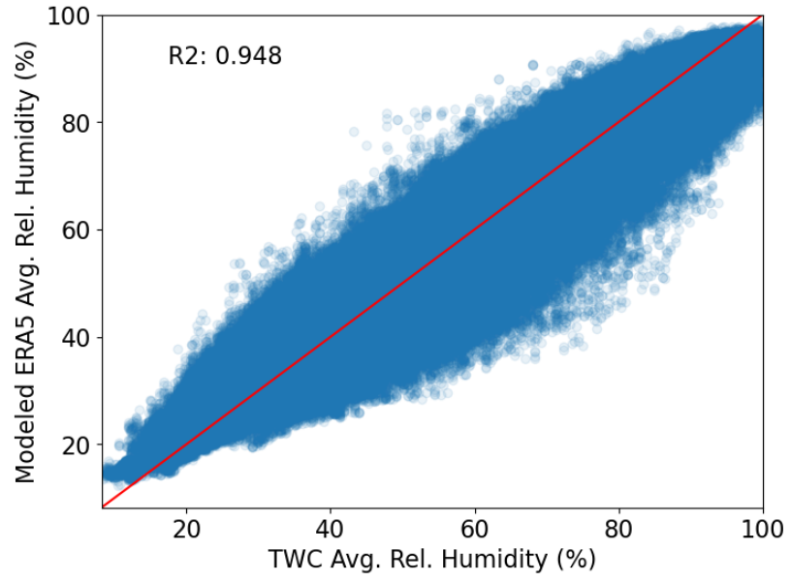
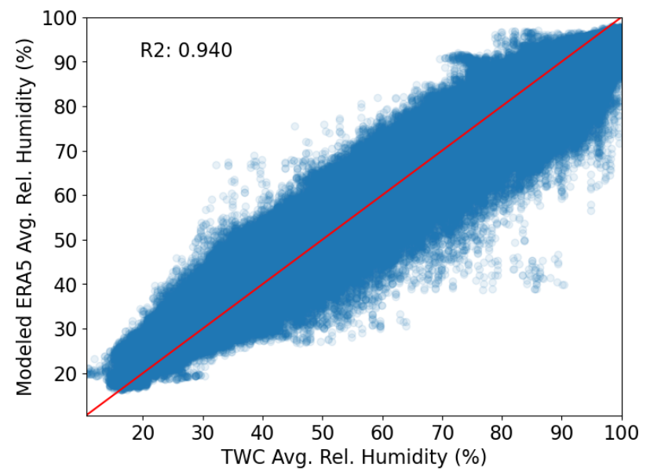
ML Model Results : Average Relative Humidity
ML model (GOSS) interpolated Average Relative Humidity has increased R² score with observed data in both train and test set.
R²:
R²:
R²:
model interpolated ERA5 data (4km) vs
TWC Data (4km)
(train set)
model interpolated ERA5 data (4km) vs
TWC Data (4km)
(test set)
resampled ERA5 data (4km) vs
TWC Data (4km)
Notes:
The left plot is a scatter plot between resampled ERA5 data and TWC training Data. For doing this comparison, I resampled the ERA5 dataset to 4km which is the resolution of the TWC dataset. The R2 score signifies that there are some correlation, but we want to improve that.
So, we apply the trained machine learning model and the R2 improves for both train and test set. The scatter plot in the middle shows the improved correlation between Modeled ERA5 data with Observed TWC data for the train set. And the 3rd plot is for the test dataset. In both of these cases, the high R2 score signifies that the model is doing well in improving the spatial resolution of average relative humidity data.
Most machine learning studies compare model performance on the train and test dataset, but we wanted to see how our model is performing for daily dataset.

Slide 16
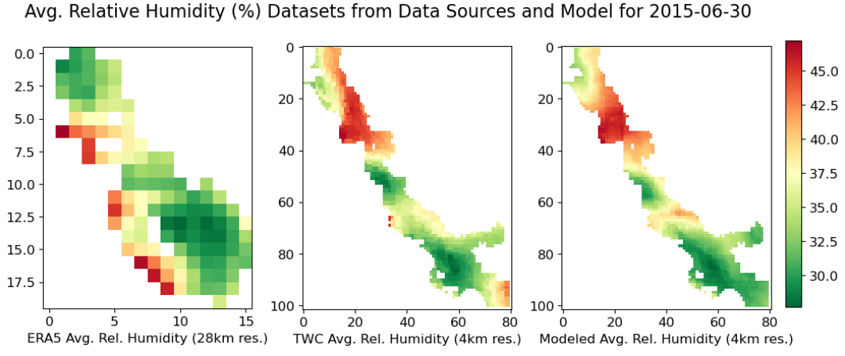
Mapping Source and Modeled Data : Average Relative Humidity
Model interpolated high-resolution Average Relative Humidity data has good spatial agreement with observed (TWC) high-resolution data.
Input Data (28 km)
TWC (Training) Data
(4 km)
Modeled Improved Resolution Data
(4 km)
Notes:
Now let’s see how the model interpolated data and the source (ERA5 and TWC) datasets look like spatially. Good spatial agreement.

Slide 17
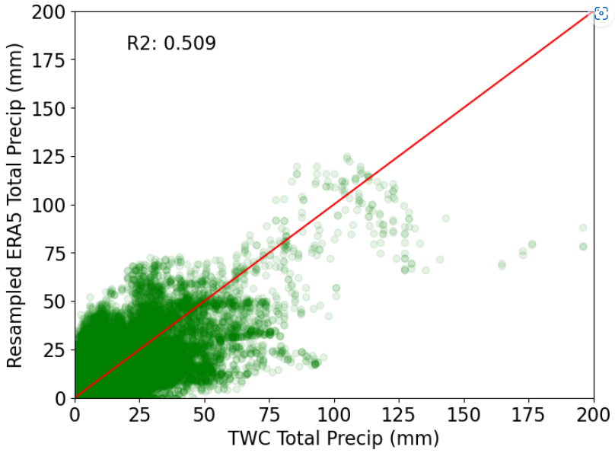
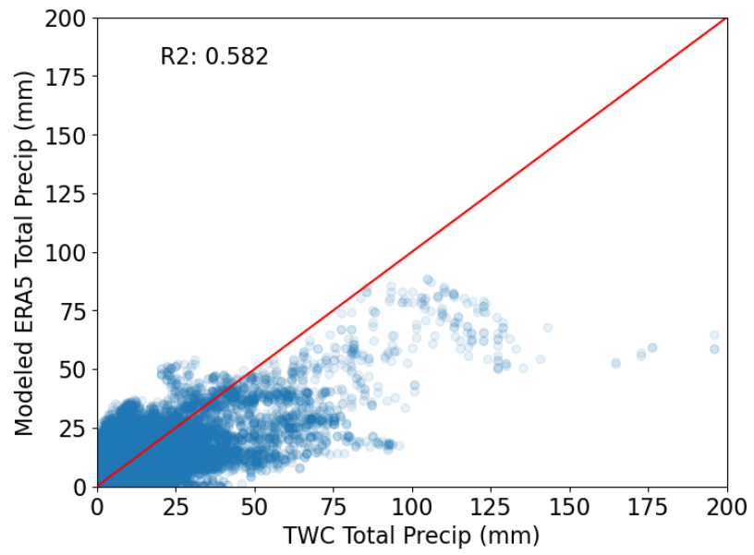
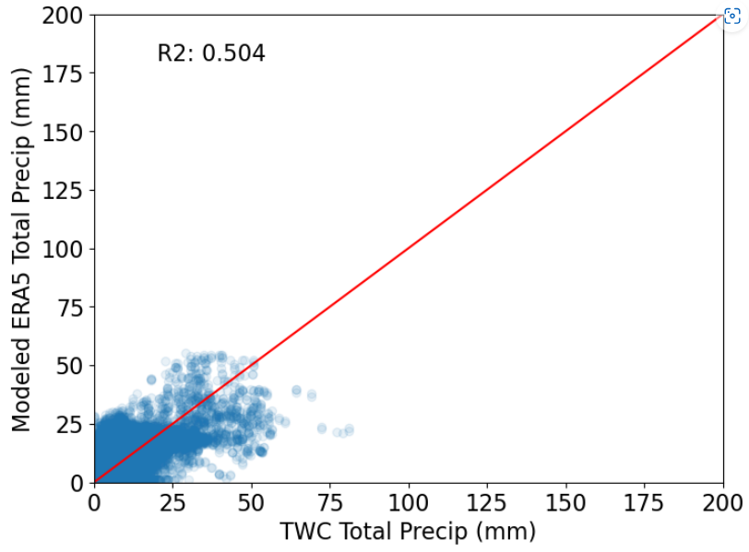
DL Model Results : Total Precipitation
Multi-Layered Perceptron (MLP) Deep Learning model overcomes overfitting to some extent.
Model performance doesn’t improve.
R²:
R²:
R²:
resampled ERA5 data (4km) vs
TWC Data (4km)
model interpolated ERA5 data (4km) vs
TWC Data (4km)
(train set)
model interpolated ERA5 data (4km) vs
TWC Data (4km)
(test set)
Notes:
To improve model performance, we applied deep learning. The green scatter plot shows the correlation between resampled ERA5 precipitation and TWC precipitation.
We found that DL solves the issue with overfitting, The scatter plots of train and test set shows there is no overfitting. But it also shows the model performance is not satisfactory.

Slide 18
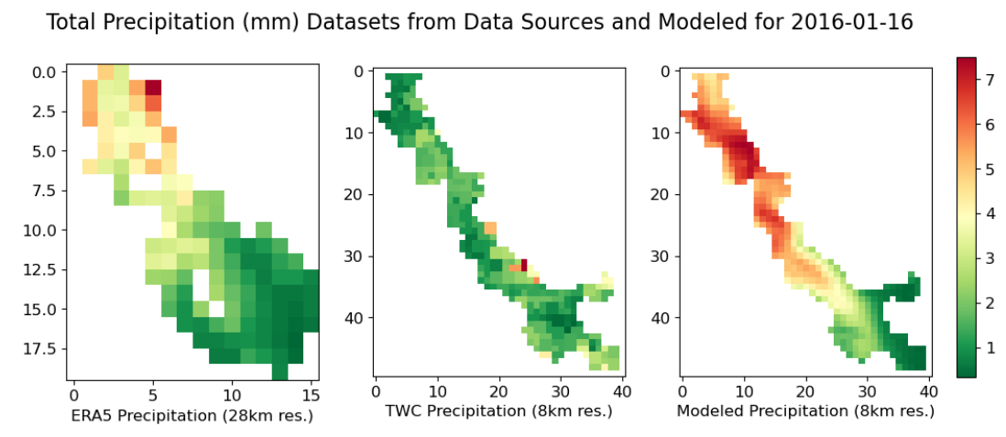
Mapping Source and Modeled Data : Total Precipitation
Model interpolated high-resolution Total Precipitation data doesn’t have good spatial agreement with observed (TWC) high-resolution data.
Notes:
When plotted with the source datasets (ERA5 and TWC), we can see that the DL model overestimates precipitation across our study region for this particular date.

Slide 19
4. Case Study: ARD in Environmental Clustering App

Slide 20
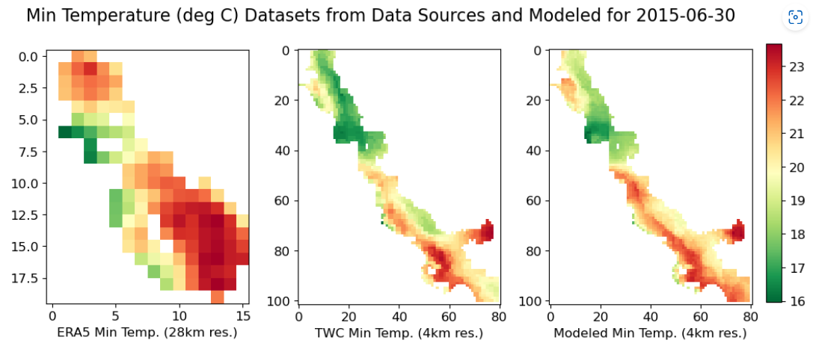
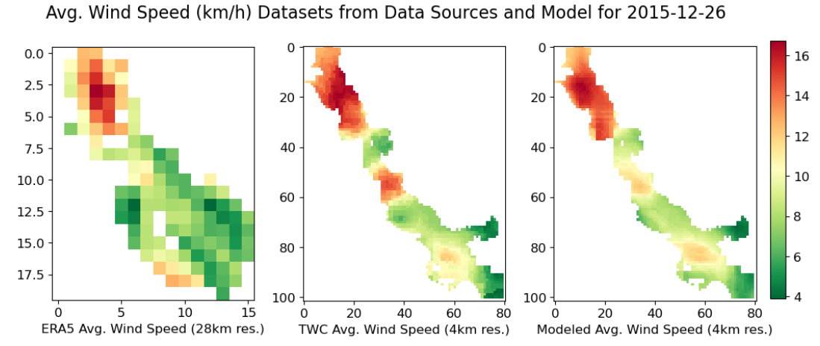
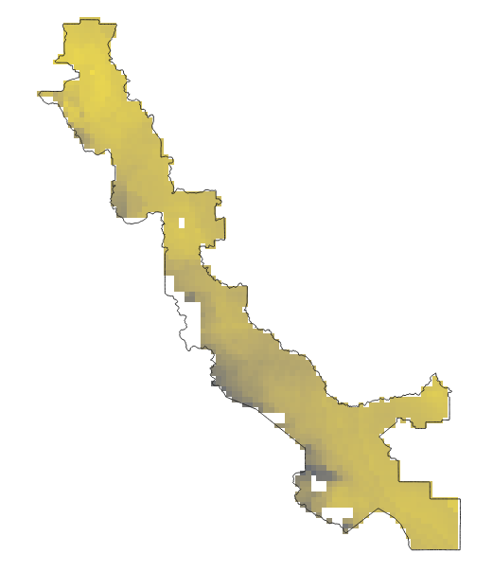
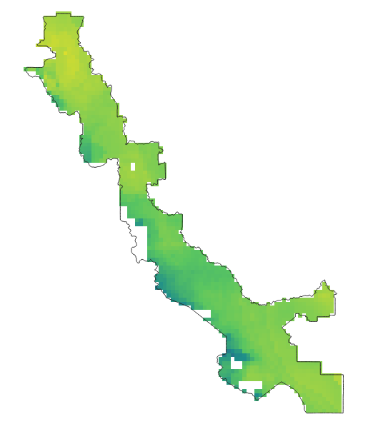
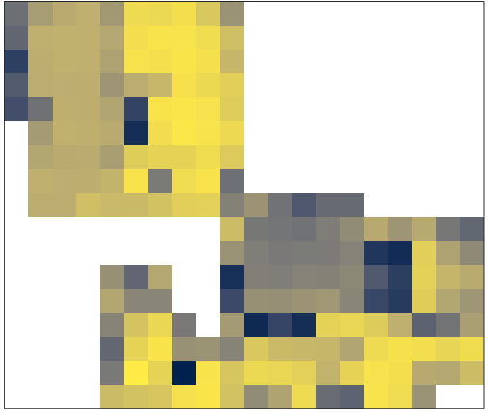
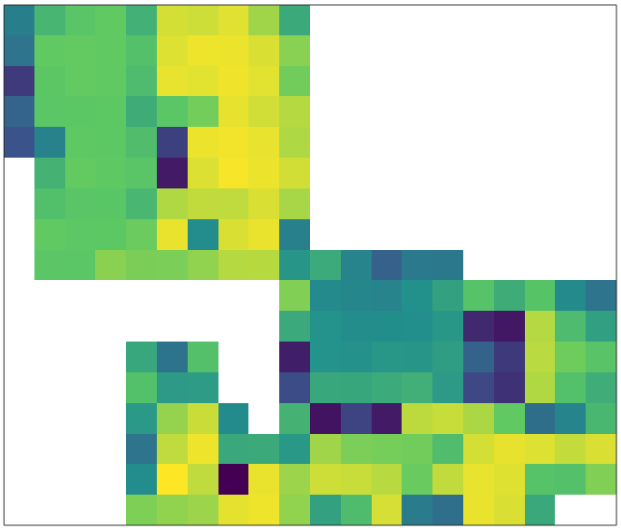
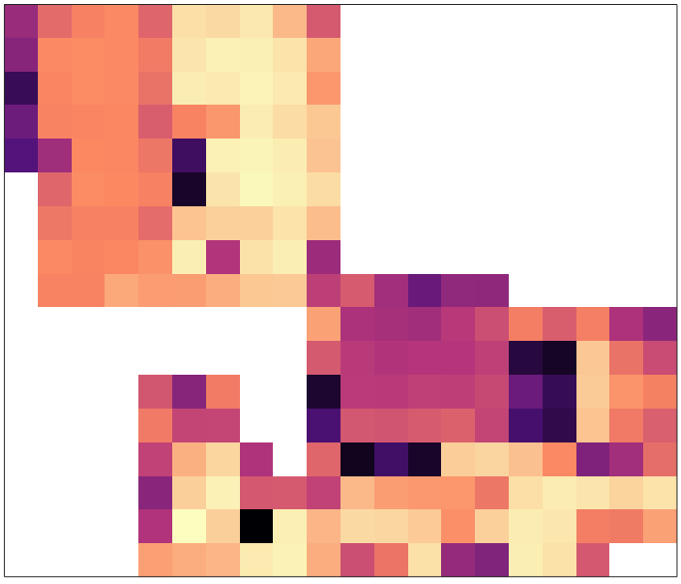
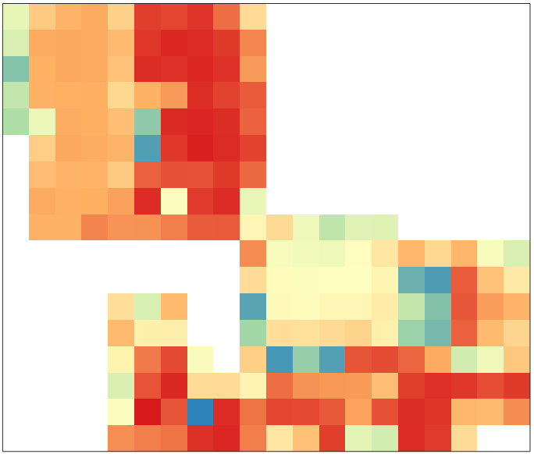
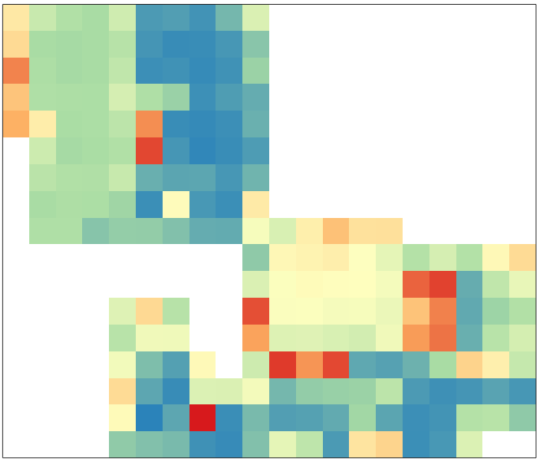
Analysis-Ready Dataset (ARD) Compilation
Modeled Weather Data
Max Temperature
Min Temperature
Average Temperature
Average Relative Humidity
Average Wind Speed
Total Precipitation
4km ARD
ERA5 Resampled Weather Data
Max Relative Humidity
Min Relative Humidity
Total Net Solar Radiation
Soil 250 Datasets
100m ARD
Elevation
Time-Series Satellite Land Surface Temp.
Notes:
After we interpolate the weather datasets with the ML models, we incorporate them into the 4km ARD. The 4km ARD have other datasets like directly resampled ERA5 datasets, soil, and elevation data.
We incorporate satellite LST data with these datasets and make the 100m version of the ARD. The 100m ARD only covers the Woodland site in California. We had to limit it to the Woodland site as LST dataset was only available for this site. With satellite dataset becoming available for other regions, we can use our framework to expand the spatial extent of the 100m ARD.

Slide 21
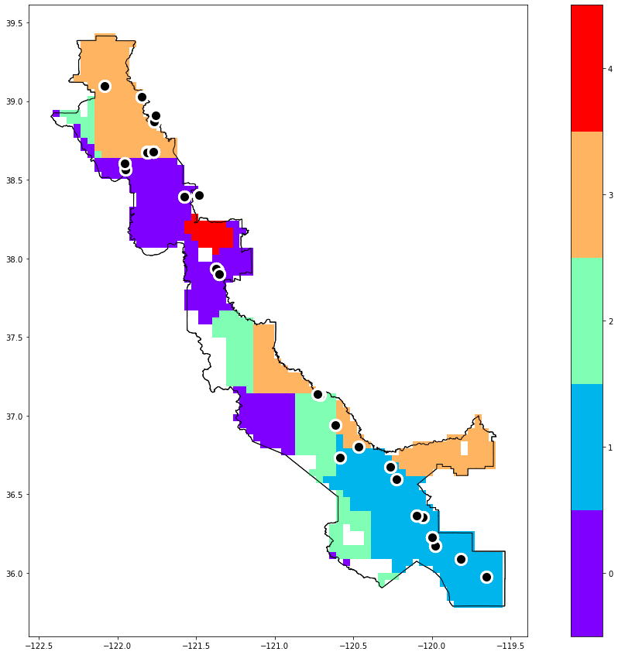
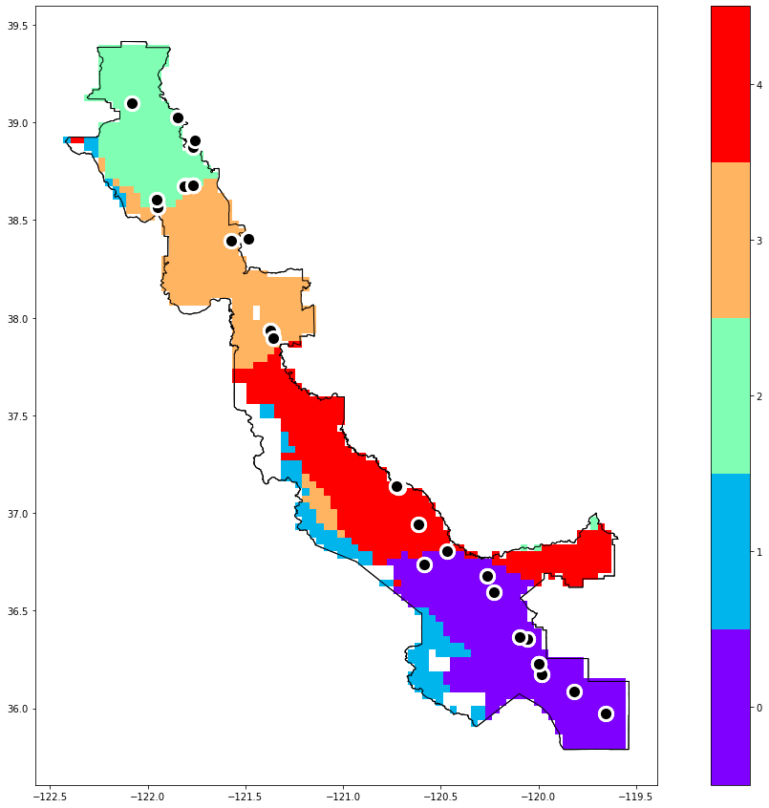
Environmental Clustering Use Case Result
Case study for California central valley, Processing Tomato whole season (field location as black dots)
Using new 4km ARD clearly improves the clustering resolution
Clustering extent has also changed, with better understanding of the field’s environmental types.
Clustering Result using
current Low-resolution Data
Clustering Result using
High-resolution ARD
Notes:
Reference Ariel.
There is no vertical and horizontal segmentation, which was happening in the PROD App due to the ERA5 low resolution data.
In the new ARD integrated cluster map, the clusters are more defined. For example, due to low resolution the nearby testing fields belong to different clusters in the PROD app, and it is difficult to resolve which cluster they actually belong to. In the new map, the fields can be clearly isolated between the clusters.

Slide 22
5. Future Steps and Summary

Slide 23
Future Steps
Optimize the Models
Apply Advanced DL Algorithms
Add High Res. Satellite Data as Input
Integrate Env Sensor and Weather Station Data for Validation
Train the Models with Data from Different Regions

Slide 24
Summary
Business Motivation: To make a scalable framework to improve performance of Env. Clustering App and other models.
Technical Motivation: To improve spatial resolution of weather datasets.
The framework included machine/deep learning + spatial interpolation methods.
ERA5 weather and elevation data were used as input datasets and TWC weather data as target/training data.
Results show improved spatial resolution for all weather models, except total precipitation model.
The framework was applied to create 4km and 100m resolution ARD.
The 4km ARD improves performance of the Env. Clustering App.

Slide 25
Acknowledgement
Veg R&D
Ariel Wang
Feng Yu
Kyle Cheung
Ignasi Montero Serra
Xing Weng
Sean Rogerson
Nan An
Martin Mendez-Costabel
Location 360
Ugochukwu Umeokafor
Qing Liu
Paul Trudt
Bobby Brauer

Slide 26
Thank you! Questions?

Slide 27
Additional Slides

Slide 28
Weather Datasets in ARD
ML/DL models have been used to generate daily data records for a 20 years timeline at high spatial resolution (4km) for six (6) weather variables.
ML/DL models for improving resolution of datasets-
Max Temperature
Min Temperature
Average Temperature
Average Relative Humidity
Average Wind Speed
Total Precipitation
Machine Learning
Deep Learning
Three (3) weather variables directly resampled to 4km due to unavailability of TWC dataset as observed/training data-
Max Relative Humidity
Min Relative Humidity
Total Net Solar Radiation
Notes:
We chose these 6 variables for ML implementation because they have estimates available in TWC dataset which can be used as training data for the models.

Slide 29
Pre-processing Datasets for ML/DL
Used Bilinear resampling (ERA5 weather datasets 28km > 4km).
Studies have found minimal/no difference between Bilinear and Krigging interpolation.
Bilinear is a much faster algorithm for large datasets.
Sources: Shao et al. 2006, Carletti et al. 2000
Notes:
- Bilinear resampling was used throughout the project as the resampling method.
- Also, Bilinear resampling was used to resample weather datasets which were not interpolated by Machine learning models from 28km to 4km resolution.

Slide 30
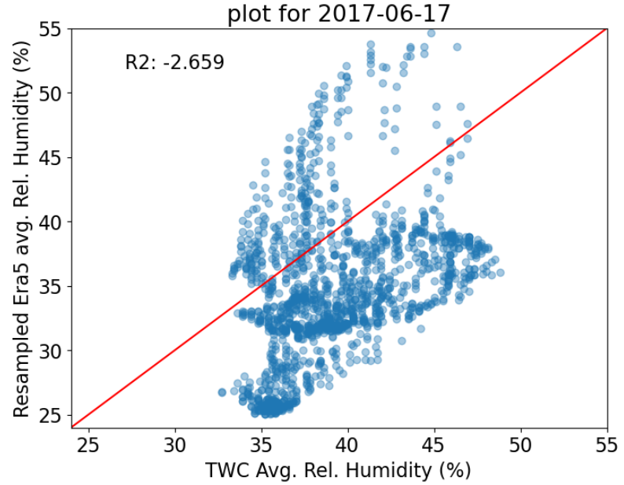
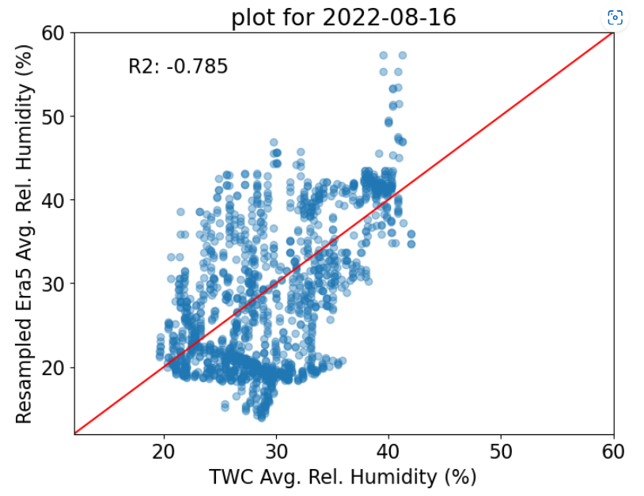
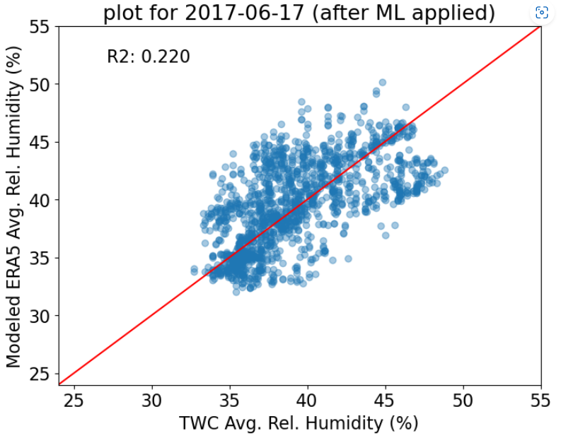
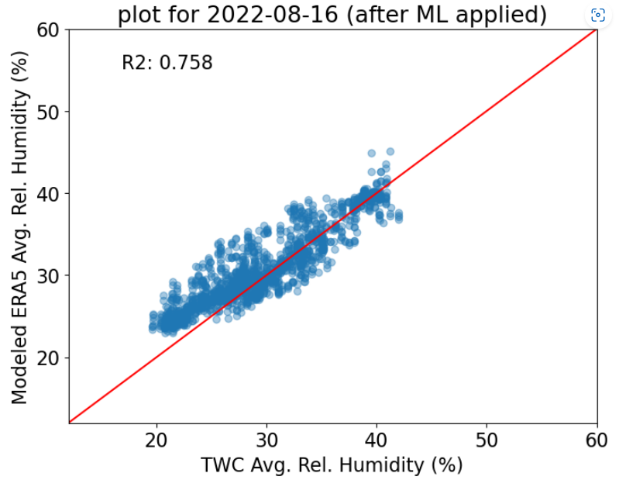
ML Model Results : Average Relative Humidity
ML model performance for randomly selected dates from the test dataset shows improved correlation between interpolated and observed Average Relative Humidity data.
R²:
R²:
Scatter Plot before
model (test set)
Scatter Plot before
model (test set)
R²:
R²:
Scatter Plot after ML
model (test set)
Scatter Plot after ML
model (test set)
Notes:
Model performance for randomly selected dates from the test dataset.

Slide 31
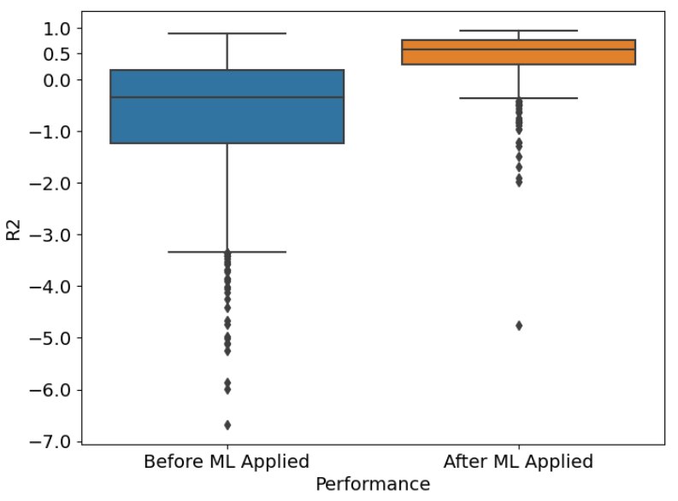
ML Model Results : Average Relative Humidity
Overall, ML model performance is satisfactory for daily Average Relative Humidity datasets in the test set.
R²
R² comparison Before and After Applying ML Model for all the days in Test Dataset
Notes:
We looked into model results for randomly selected dates in the previous slide. But we also wanted to see how the model does for all dates in the test dataset. The blue boxplot shows range of R2 scores for days before ML was applied and the R2 scores are mostly negative. The orange plot shows the R2 scores after the trained ML was applied and it shows that how the ML model improves R2 score for daily datasets.
This boxplot confirms that the ML model performs well for average relative humidity at daily scale.

Slide 32
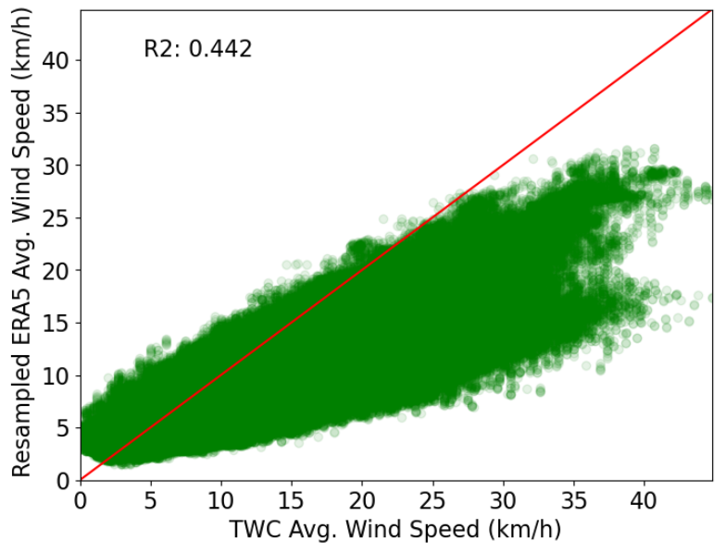
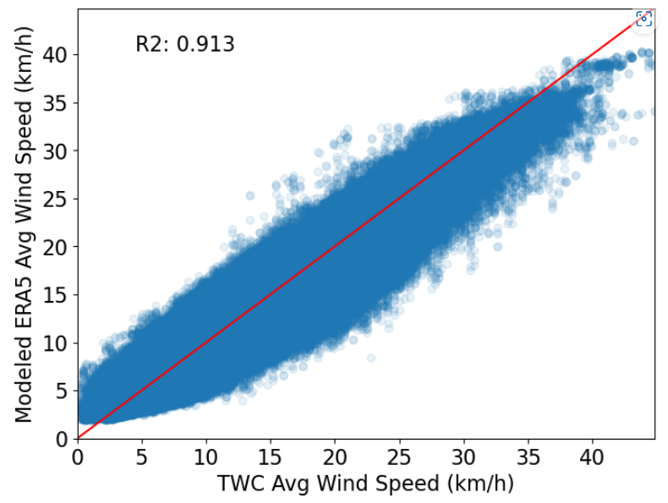
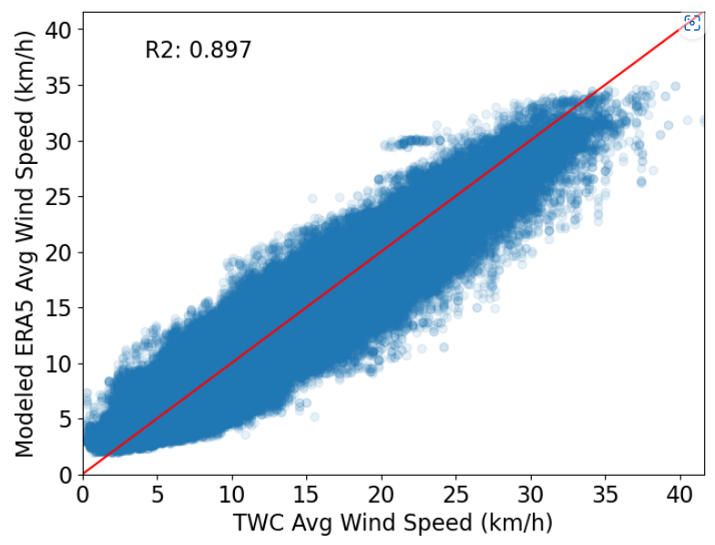
ML Model Results : Average Wind Speed
ML model (GOSS) interpolated Average Wind Speed has improved R² correlation with observed data in both train and test set.
resampled ERA5 data (4km) vs
TWC Data (4km)
model interpolated ERA5 data (4km) vs
TWC Data (4km)
(train set)
model interpolated ERA5 data (4km) vs
TWC Data (4km)
(test set)

Slide 33
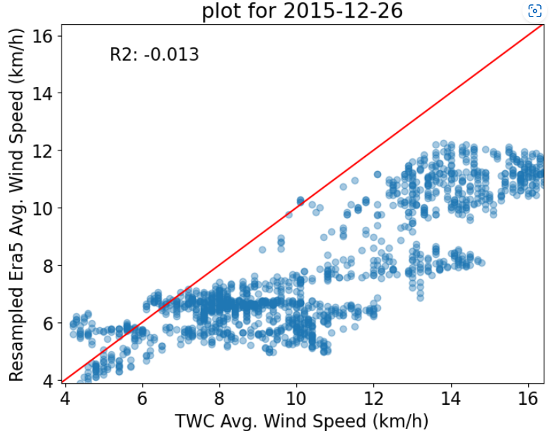
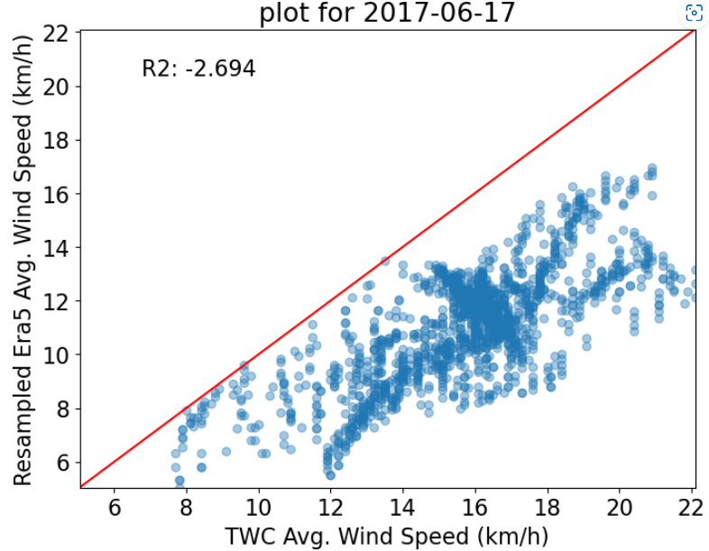
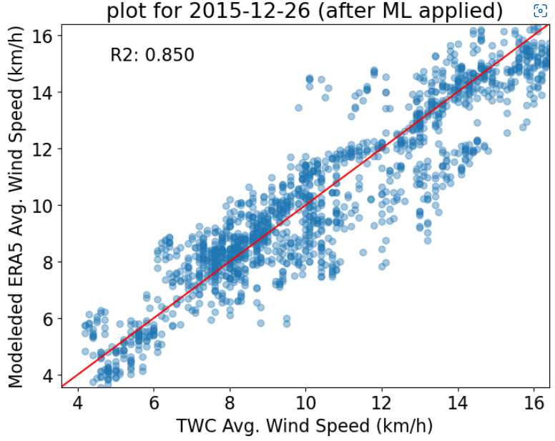
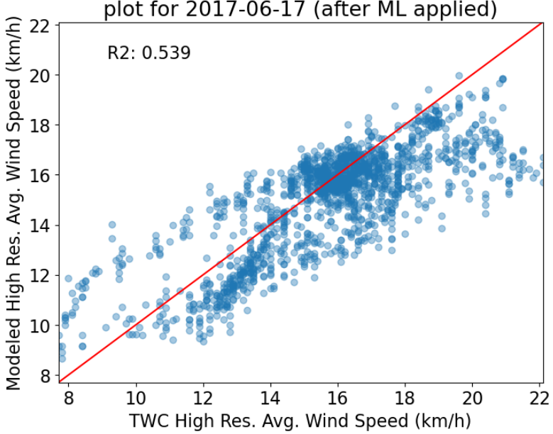
ML Model Results : Average Wind Speed
ML model performance for randomly selected dates from the test dataset shows better correlation between interpolated and observed Average Wind Speed data.
Scatter Plot before
model (test set)
Scatter Plot before
model (test set)
Scatter Plot after ML
model (test set)
Scatter Plot after ML
model (test set)
Notes:
Model performance for randomly selected date

Slide 34
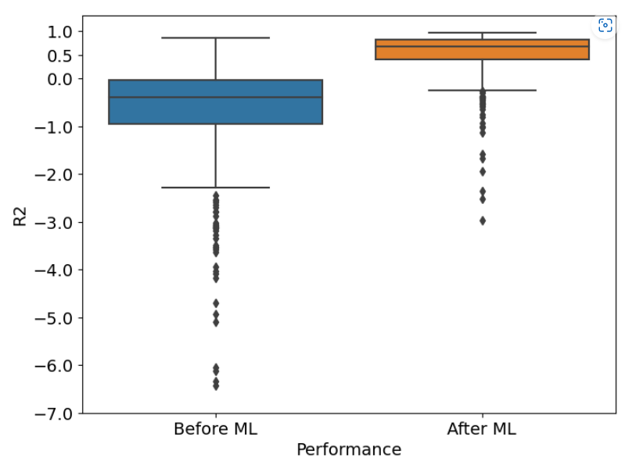
ML Model Results : Average Wind Speed
Overall, ML model performance is satisfactory for daily Average Wind Speed datasets from the test set.
Before ML applied
After ML applied
Performance
R² comparison Before and After Applying ML Model for days in Test Dataset

Slide 35
Mapping Source and Modeled Data : Average Wind Speed
Model interpolated high-resolution Average Wind Speed data has good spatial agreement with observed (TWC) high-resolution data.

Slide 36
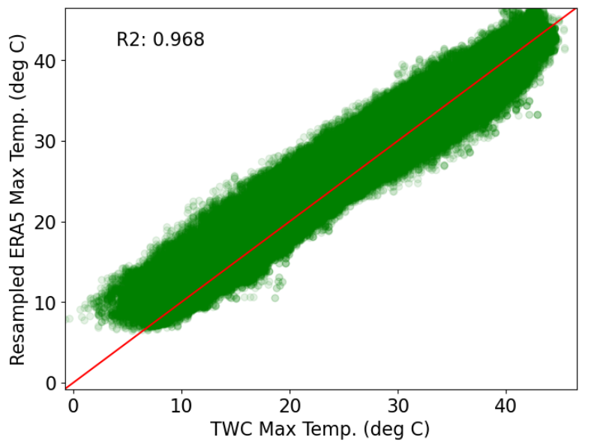
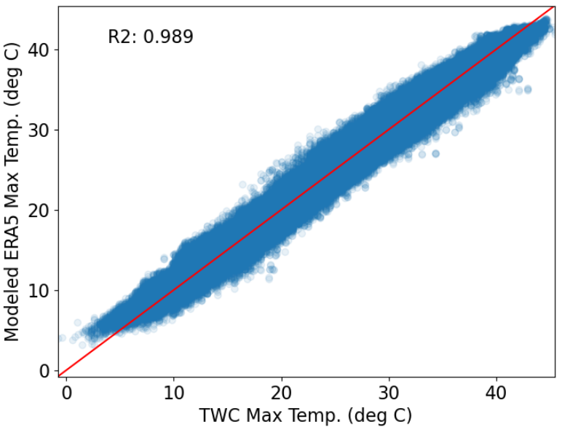
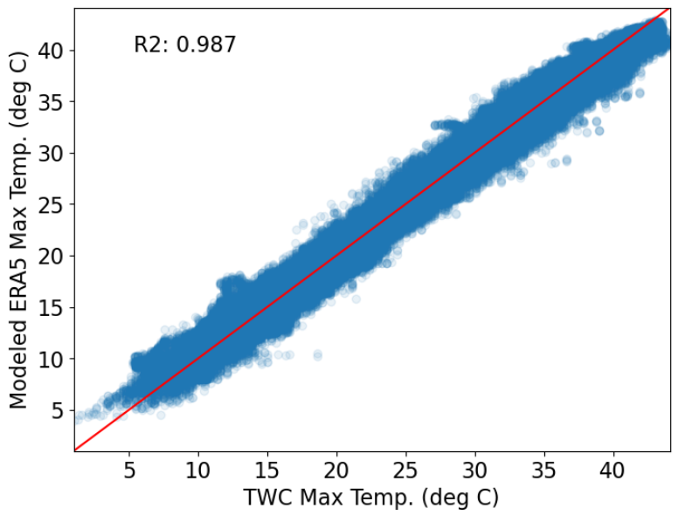
ML Model Results : Maximum Temperature
ML model (GOSS) interpolated Maximum Temperature has improved R² correlation with observed data in both train and test set.
R²:
R²:
R²:
model interpolated ERA5 data (4km) vs
TWC Data (4km)
(train set)
model interpolated ERA5 data (4km) vs
TWC Data (4km)
(test set)
resampled ERA5 data (4km) vs
TWC Data (4km)
Notes:
The left plot is a scatter plot between resampled ERA5 max temp and Observed TWC max temp. For doing this comparison, I resampled the ERA5 dataset to 4km which is the resolution of the TWC dataset. The R2 score signifies that there are already good correlation, but we want to improve that.
So, we apply the trained machine learning model and the R2 improves for both train and test set.

Slide 37
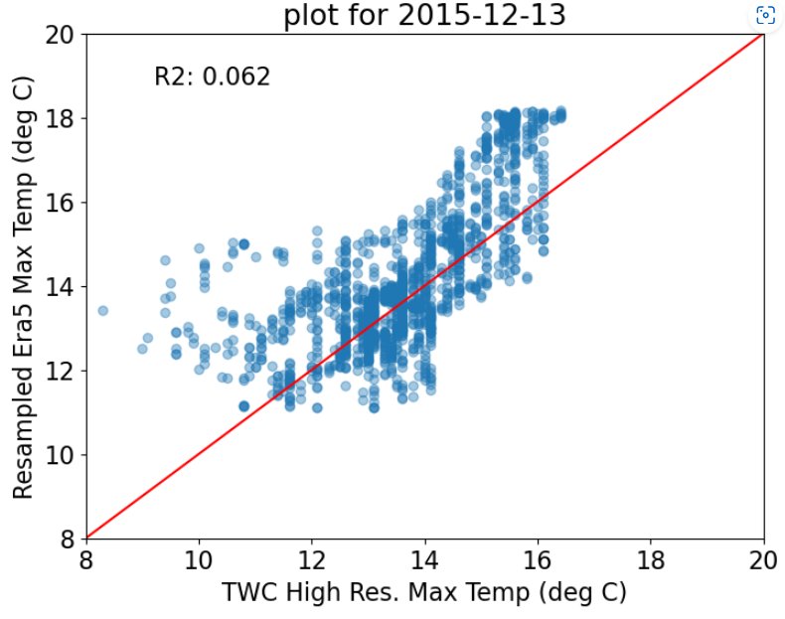
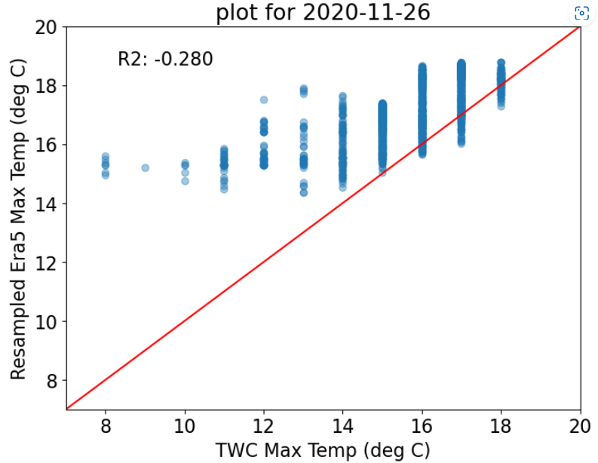
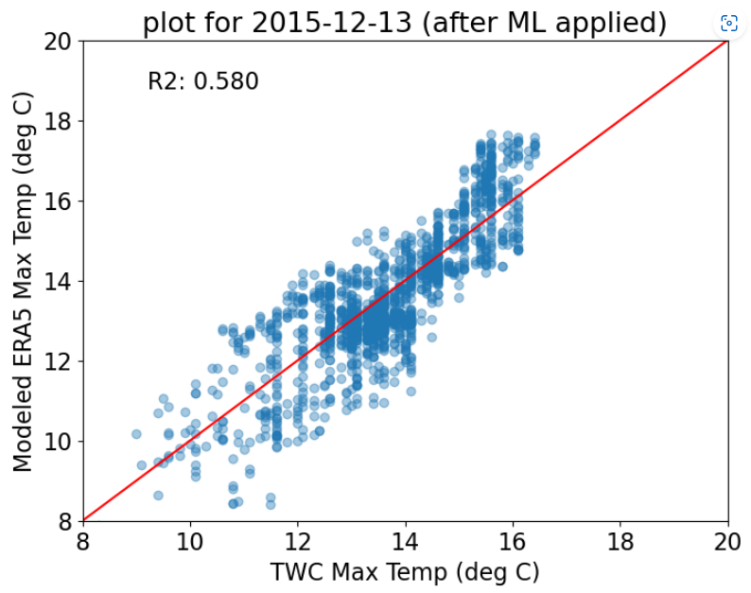
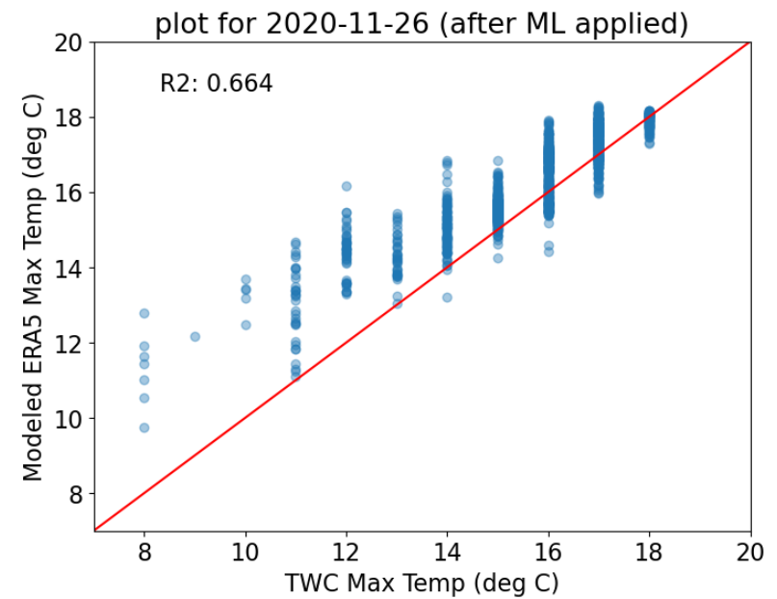
ML Model Results : Maximum Temperature
ML model performance for randomly selected dates from the test dataset shows better correlation between interpolated and observed Maximum Temperature data.
Scatter Plot before
model (test set)
Scatter Plot before
model (test set)
Scatter Plot after ML
model (test set)
Scatter Plot after ML
model (test set)
Notes:
Model performance for randomly selected date

Slide 38
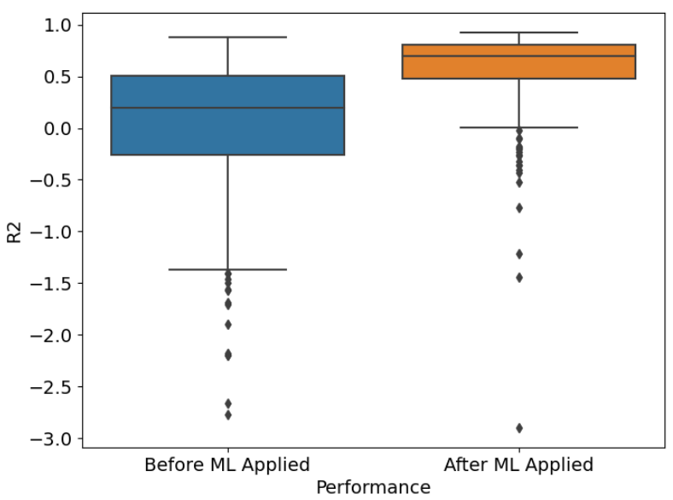
ML Model Results : Maximum Temperature
Overall, ML model performance is satisfactory for daily Maximum Temperature datasets in the test set.
R²
R² comparison Before and After Applying ML Model for all the days in Test Dataset
Notes:
Similar to Avg. Rel. Humidity, the boxplot here is showing how the model performs for all dates in test dataset for maximum temperature model. The blue boxplot shows range of R2 scores before ML was applied and you can see that the R2 scores are quite good. The orange plot shows the R2 scores are further improved after the trained ML was applied. This shows that how the ML model performs well for maximum temperature at daily scale.

Slide 39
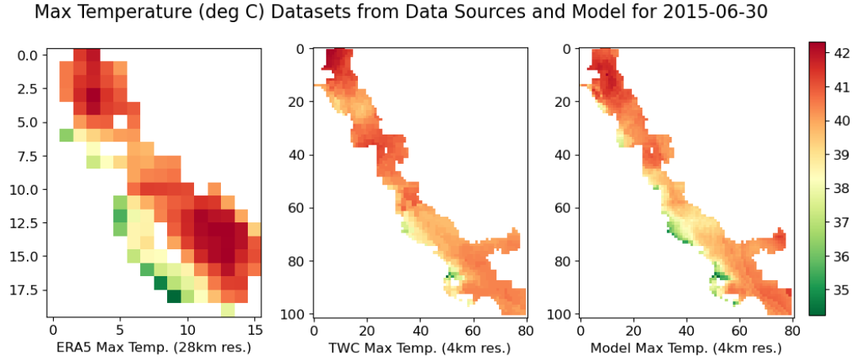
Mapping Source and Modeled Data : Maximum Temperature
Model interpolated high-resolution Maximum Temperature data has good spatial agreement with observed (TWC) high-resolution data.
Notes:
When plotted with the source datasets (ERA5 and TWC) the interpolated data shows good spatial agreement throughout the study region.

Slide 40
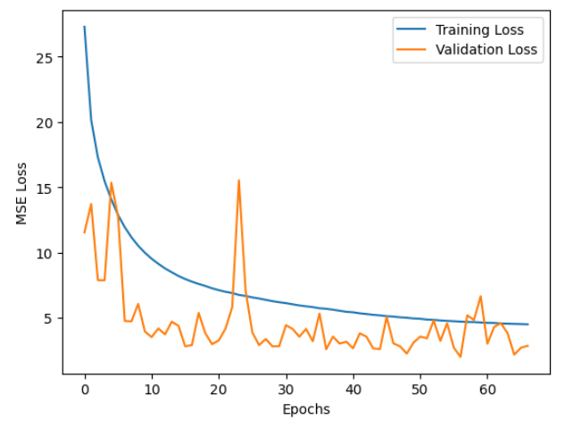
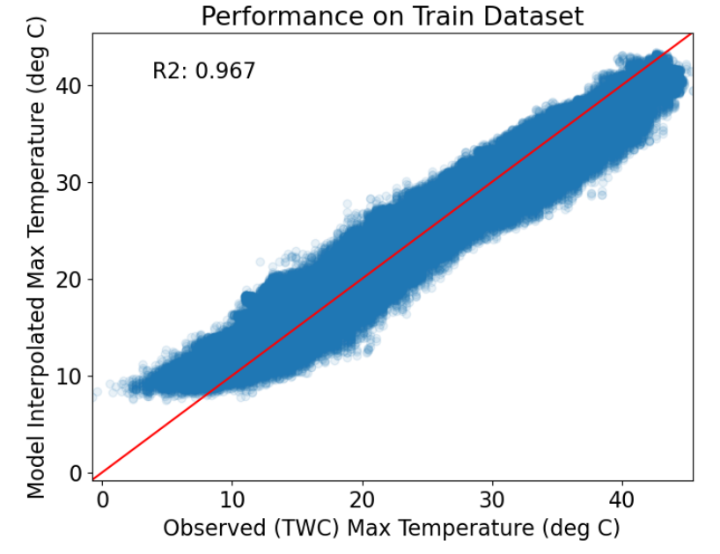

ML/DL Model Results Comparison : Maximum Temperature
ML :
Gradient-Boosting Decision Tree
Performance train set
Performance test set
DL :
Multi-Layered Perceptrons (MLP)
Learning Curve: MLP training
Performance train set
Performance test set

Slide 41


ML Model Results : Total Precipitation
Training data: TWC High Res. (8km) Precipitation data.
Input Variables: model interpolated high resolution datasets (min/max/avg temperature, avg relative humidity, avg wind speed) (resampled to 8km), resampled total precipitation (ERA5), elevation, lat/lon, month.
GOSS (LightGBM) overfits the model.
Hyperparameter tuning failed to remove overfitting.
R²:
R²:
R²:
resampled ERA5 data (8km) vs
TWC Data (8km)
model interpolated ERA5 data (8km) vs
TWC Data (8km)
(train set)
model interpolated ERA5 data (8km) vs
TWC Data (8km)
(test set)

Slide 42

DL Model Results : Total Precipitation
Measures explored to improve MLP ‘Total Precipitation’ performance:
different ratio of train-test-validation split
simple and complex model architectures
adjusting hyperparameter values
different optimizers
early stopping, dropout, adding/removing features
Future works:
More architectures and different sets of hyperparameters
New data splitting strategy to remove skewness in data
Incorporating more samples in training/observed dataset
Incorporating high resolution datasets in input variables
Trying out complex DL algorithms : CNN, UNet, LSTM (Gonzalez 2023, Wang et al. 2022, Sha et al. 2020, Anh et al. 2019)
Exploring Sensor/Station data to discover insights.
Notes:
One of the reasons why the precipitation model didn’t work well is the skewness in the dataset. Precipitation dataset has many zero values making the dataset skewed towards zero. Due to this skewness, our data splitting strategy isn’t doing well, and we see performance gap between train and validation dataset.

Slide 43
ML/DL Model Results : R² comparison
Variable | Days in Test Dataset | Negative R² before model (days) | Negative R² after model (days) | R² > 0.3 after model (days) | R² > 0.5 after model (days) | R² > 0.6 after model (days)
Avg Wind Speed | 572 | 437 | 61 | 455 | 386 | 334
Avg Rel Humidity | 572 | 377 | 75 | 421 | 326 | 272
Max Temperature** | 294 | 112 | 21 | 250 | 215 | 180
Minimum Temperature** | 294 | 270 | 30 | 214 | 148 | 114
** Max/Min Temperature model dataset was filtered for dates before Aug 2019 before performing 80-20 train-test data split.

Slide 44
References
Shao, X., Stein, M., & Ching, J. (2007). Statistical comparisons of methods for interpolating the output of a numerical air quality model. Journal of Statistical Planning and Inference, 137(7), 2277-2293.
Carletti, R., Picci, M., & Romano, D. (2000). Kriging and bilinear methods for estimating spatial pattern of atmospheric pollutants. Environmental Monitoring and Assessment, 63, 341-359.
Tran Anh, D., Van, S. P., Dang, T. D., & Hoang, L. P. (2019). Downscaling rainfall using deep learning long short‐term memory and feedforward neural network. International Journal of Climatology, 39(10), 4170-4188.
Baez-Villanueva, O. M., Zambrano-Bigiarini, M., Beck, H. E., McNamara, I., Ribbe, L., Nauditt, A., ... & Thinh, N. X. (2020). RF-MEP: A novel Random Forest method for merging gridded precipitation products and ground-based measurements. Remote Sensing of Environment, 239, 111606.
Chen, C., Hu, B., & Li, Y. (2021). Easy-to-use spatial random-forest-based downscaling-calibration method for producing precipitation data with high resolution and high accuracy. Hydrology and Earth System Sciences, 25(11), 5667-5682.
Gonzalez, C. A. G. (2023). DL4DS—Deep learning for empirical downscaling. Environmental Data Science, 2, e3.
Li, X., Li, Z., Huang, W., & Zhou, P. (2020). Performance of statistical and machine learning ensembles for daily temperature downscaling. Theoretical and Applied Climatology, 140, 571-588.
Sha, Y., Gagne II, D. J., West, G., & Stull, R. (2020). Deep-learning-based gridded downscaling of surface meteorological variables in complex terrain. Part I: Daily maximum and minimum 2-m temperature. Journal of Applied Meteorology and Climatology, 59(12), 2057-2073.
Sha, Y., Gagne II, D. J., West, G., & Stull, R. (2020). Deep-learning-based gridded downscaling of surface meteorological variables in complex terrain. Part II: Daily precipitation. Journal of Applied Meteorology and Climatology, 59(12), 2075-2092.
Wang, F., Tian, D., & Carroll, M. (2023). Customized deep learning for precipitation bias correction and downscaling. Geoscientific Model Development, 16(2), 535-556.
Sun, A. Y., & Tang, G. (2020). Downscaling satellite and reanalysis precipitation products using attention-based deep convolutional neural nets. Frontiers in Water, 2, 536743.

Slide 45
ML/DL Model Results : Training Time Performance
Variable | Days in training data | **LGBM training time (minute) | ***LGBM training time with hyperparameter tuning (minute) | *Deep Learning training time (minute)
Max Temperature | 1175 | 0.19 | ~30 | 42 for 63 epochs
Min Temperature | 1175 | 0.19 | ~26 | -
Avg. Wind Speed | 2001 | 0.37 | ~26 | -
Total precipitation | 1628 (LGBM) 1356 (DL) | 0.044 | ~40 | 7.9 for 60 epochs
*** Tuned LGBM model for 09 hyperparameters with 10-fold Randomized CV. A total of 500 combinations of hyperparameters were tested.
** For LGBM, used instance ml.m5.4xlarge
* For DL, used instance ml.p3.2xlage

Slide 46

LightGBM
A library implementing Decision Tree type machine learning models.
Uses ‘Boosting’ instead of ‘Bagging’.
More hyperparameters available to handle overfitting.
Very fast, low memory usage for large datasets.
Supports parallel, distributed, and GPU learning.
Better performance than RF if properly tuned.
Gradient-based One-Side Sampling (GOSS) algorithm: uses large gradients only for information gain. Doesn’t consider smaller gradients.
Sources: LightGBM, Medium
Figure Source: Analytics Vidhya

